Slide 1
SARS CoV-2 / COVID-19 Prediction Using Corona Virus Genome Sequence
Theme = Social Impact

Slide 2
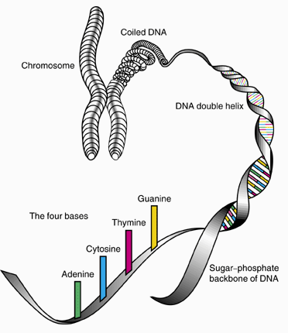
Team Name = ClassApart
Team Members
Anubhav Mishra
Neeraj Joshi
Shruti Tyagi

Slide 3
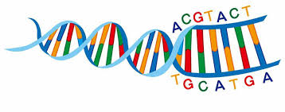
DNA SEQUENCING
DNA sequencing refers to the analysis of the base sequence of a specific DNA fragment, that is, the adenine (A), thymine (T), cytosine (C)and guanine (G) arrangement. the way.
The advent of rapid DNA sequencing methods has greatly facilitated research and discovery in biology and medicine.
In basic biology research, and in numerous fields of application such as diagnostics, biotechnology, forensic biology, and biosystematics, DNA sequence knowledge has become indispensable knowledge.
Rapid sequencing speeds with modern DNA sequencing technology have helped to sequence complete DNA sequences, or multiple types of genome sequencing and life species, including the human genome and many other animal, plant and microbial species complete DNA sequences.

Slide 4
PROJECT DESCRIPTION
We have collected the dataset of Human DNA Sequence with label.
NLP CountVectorizer is used for making a bag of sequences, where each bag has a fixed length of sequence.
Now this bag is trained via machine learning algorithm - Naive Bayes Classifier.
The accuracy score obtained was around 0.97.
Now, another dataset was used which contains the information of cases of COVID in various countries.
Linear Regressor model is used to measure the trajectory of COVID with respect to time.

Slide 5
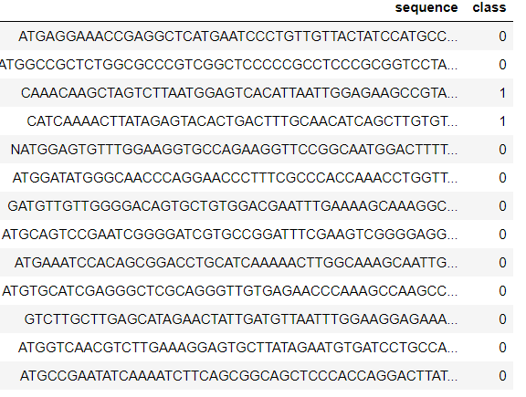
Label
Sequence of DNA
Human Dataset - feature (Sequence), target (class)

Slide 6
COUNTVECTORIZER - NLP
Count Vectorization involves counting the number of occurrences each words appears in a document (i.e distinct text such as an article, book, even a paragraph!).
Python’s Sci-kit learn library has a tool called CountVectorizer to accomplish this.
Inverse document frequency takes the logarithmic function of the size of the set of documents, D, and in how many documents a word appears even if it appears more than once within a document.
This is then multiplied by the term frequency to get a score.

Slide 7
NAIVE BAYES ALGORITHM
Statistical method for classification.
Supervised Learning Method.
Assumes an underlying probabilistic model, the Bayes theorem.
Can solve problems involving both categorical and continuous valued attributes.
It works on the Bayes Theorem: P(H|X)= P(X|H) P(H)/ P(X), where H is the target and X represents the features.

Slide 8
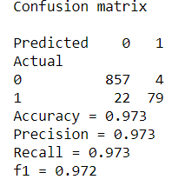
CONFUSION MATRIX OF MODEL
The accuracy obtained is so far good compared to other classifier algorithm. The random state taken was 42 with a test_size of 20% of entire data set.

Slide 9
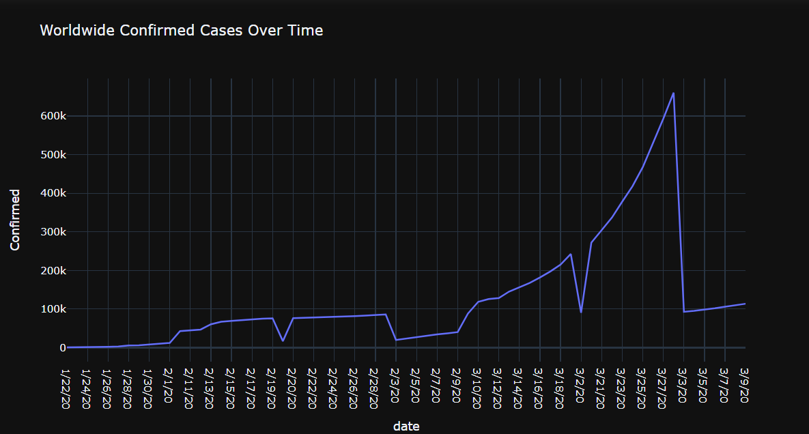
ANALYSING THE GROWTH OF COVID

Slide 10
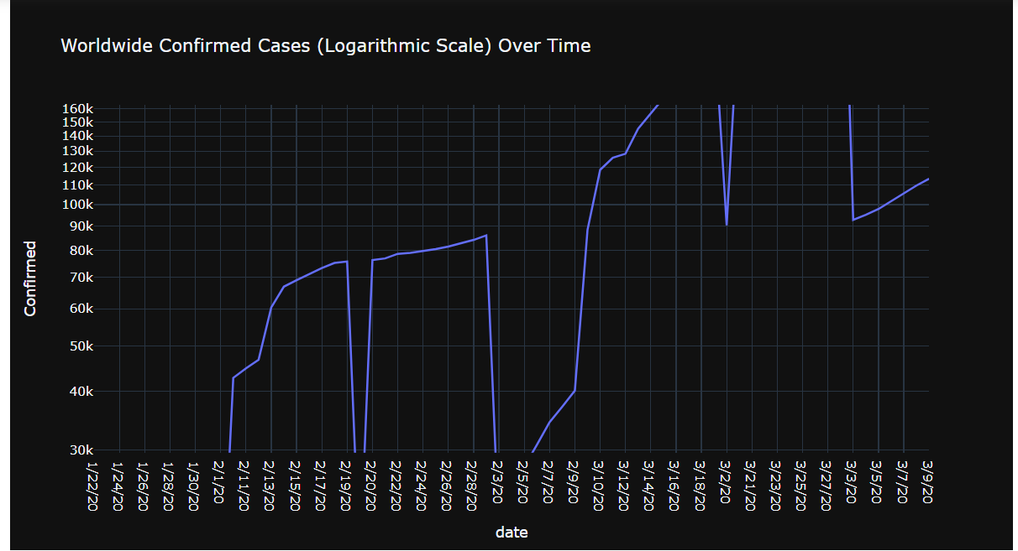

Slide 11
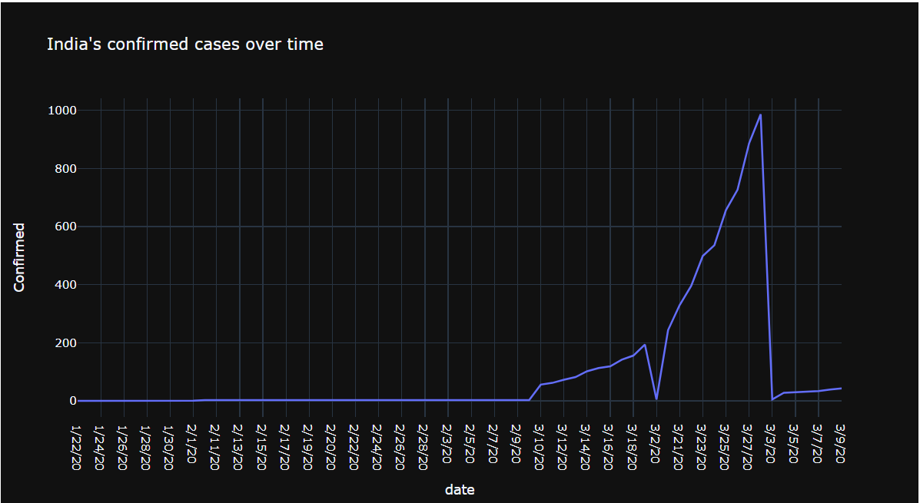

Slide 12
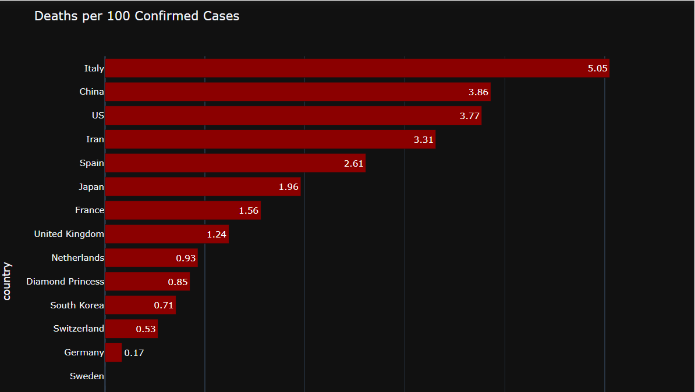

Slide 13
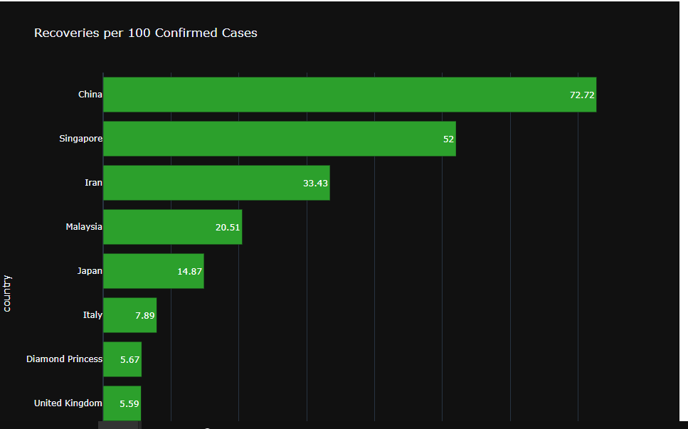

Slide 14
LINEAR REGRESSION
The current capturing cases of COVID datset is used and trained via Linear Regression algorithm.
Regression is a method of modelling a target value based on independent predictors.
This method is mostly used for forecasting and finding out cause and effect relationship between variables.
Regression techniques mostly differ based on the number of independent variables and the type of relationship between the independent and dependent variables.
The characteristics is shown in the next plot.

Slide 15
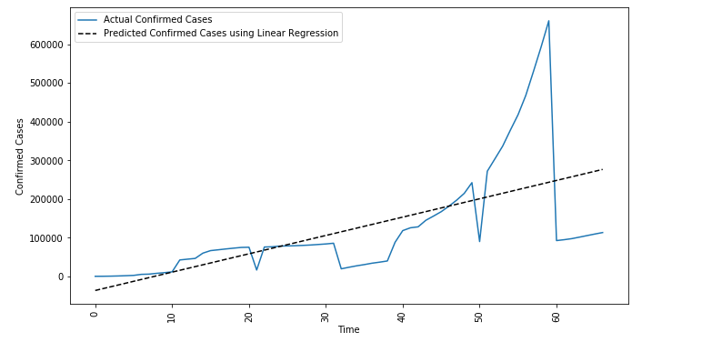

Slide 16

Microsoft Azure Services Used And Those which can be used in Future Applications
Machine Learning Studio ( Classic ) workspace.
Machine Learning Studio ( Classic ) web services.
Microsoft Genomics
VS Code Extension
Software As a Service ( SaaS )
Microsoft Kubernetes Services
Azure Backup
Logic App
Jupyter Notebooks : SDK for Python
Azure API for FHIR

Slide 17
BUSINESS MODEL
Our Project deals with matching the DNA Sequence with COVID and predicting the outcome of whether oneself is infected or not.
The model used is Naive Bayes and Natural Language Processing, which gives a far good accuracy. So by such a good accuracy, the new sequence DNA Sequence can be easily computed irrespective of manually matching, and it would be helpful to the upcoming generation.
Analysing and studying the disease is more important in curing out of it. SO our model predict the rate through which disease is growing in different countries and how further it will impact in future.
Sureley, this model will help in predicting the behaviour of a disease for the future aspect. So that necessary things should be done before its actual arrival in an country.

Slide 18
THANK YOU

